Slide 1
HOSPITALITY
DASHBOARD
Hospitality Dashbord - Power BI

Slide 2
Problem Statement:
Atliq Grands owns multiple five-star hotels across India. They have been in the hospitality industry for the past 20 years. Due to strategic moves from other competitors and ineffective decision-making in management, Atliq Grands are losing its market share and revenue in the luxury/business hotels category. As a strategic move, the managing director of Atliq Grands wanted to incorporate “Business and Data Intelligence” in order to regain their market share and revenue. However, they do not have an in-house data analytics team to provide them with these insights. Their revenue management team had decided to hire a 3rd party service provider to provide them insights from their historical data. Task: You are a data analyst who has been provided with sample data and a mock-up dashboard to work on the following task. You can download all relevant documents from the download section.
Create the metrics according to the metric list.
Create a dashboard according to the mock-up provided by stakeholders.
Create relevant insights that are not provided in the metric list/mock-up dashboard.

Slide 3
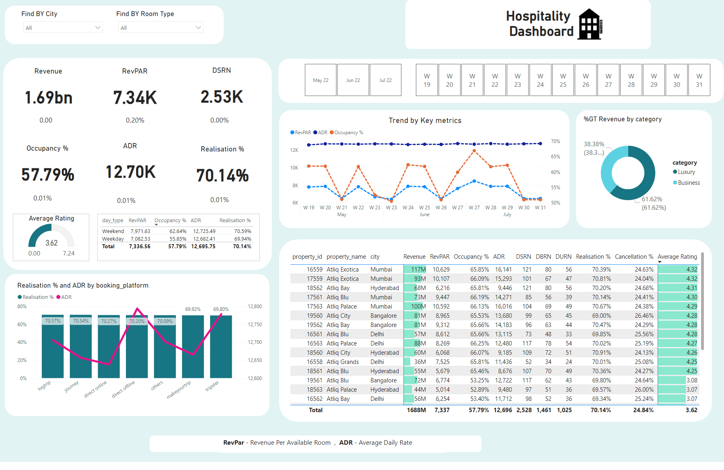
Home
Notes:
tableEx
No alt text provided
Find BY City
No alt text provided
Find BY Room Type
No alt text provided
Find BY Date
No alt text provided
slicer
No alt text provided
Revenue
No alt text provided
tableEx
No alt text provided
donutChart
No alt text provided
textbox
No alt text provided
pivotTable
No alt text provided
DSRN
No alt text provided
pivotTable
No alt text provided
Occupancy %
No alt text provided
pivotTable
No alt text provided
ADR
No alt text provided
Realisation %
No alt text provided
pivotTable
No alt text provided
pivotTable
No alt text provided
gauge
No alt text provided
image
No alt text provided
Trend by Key metrics
No alt text provided
tableEx
No alt text provided
lineStackedColumnComboChart
No alt text provided
shape
No alt text provided
shape
No alt text provided
shape
No alt text provided
shape
No alt text provided
shape
No alt text provided
shape
No alt text provided
shape
No alt text provided
shape
No alt text provided
RevPAR
No alt text provided
shape
No alt text provided
textbox
No alt text provided

Slide 4
Insight :
We have taken a 3 month dataset of Atliq Grands to get the insights of market share and revenue in the luxury/business hotels category.
The Key metrics shows us the to find out the trend that in which week the Atliq Grands have faced more loss and profit to take the necessary decision according to the insights.
Below the KPIs the small values are shown which gives us the indication that it is profitable or not .
There are 2 category of rooms in that Luxury rooms given us the 61.6% of Revenue which is higher than Business category.
The Trend chart shows us the trend Occupancy% , RevPAR(Revenue Per Available Rooms) , ADR(Average Daily Rate) which gives direct information which week has more occupancy which is having a loss
The table gives us the detail information about each property and its average rating along with revenue and city .
The weekdays and weekends are different for hotels , by observing the table the occupancy of hotel rooms is more on weekends.

Slide 5
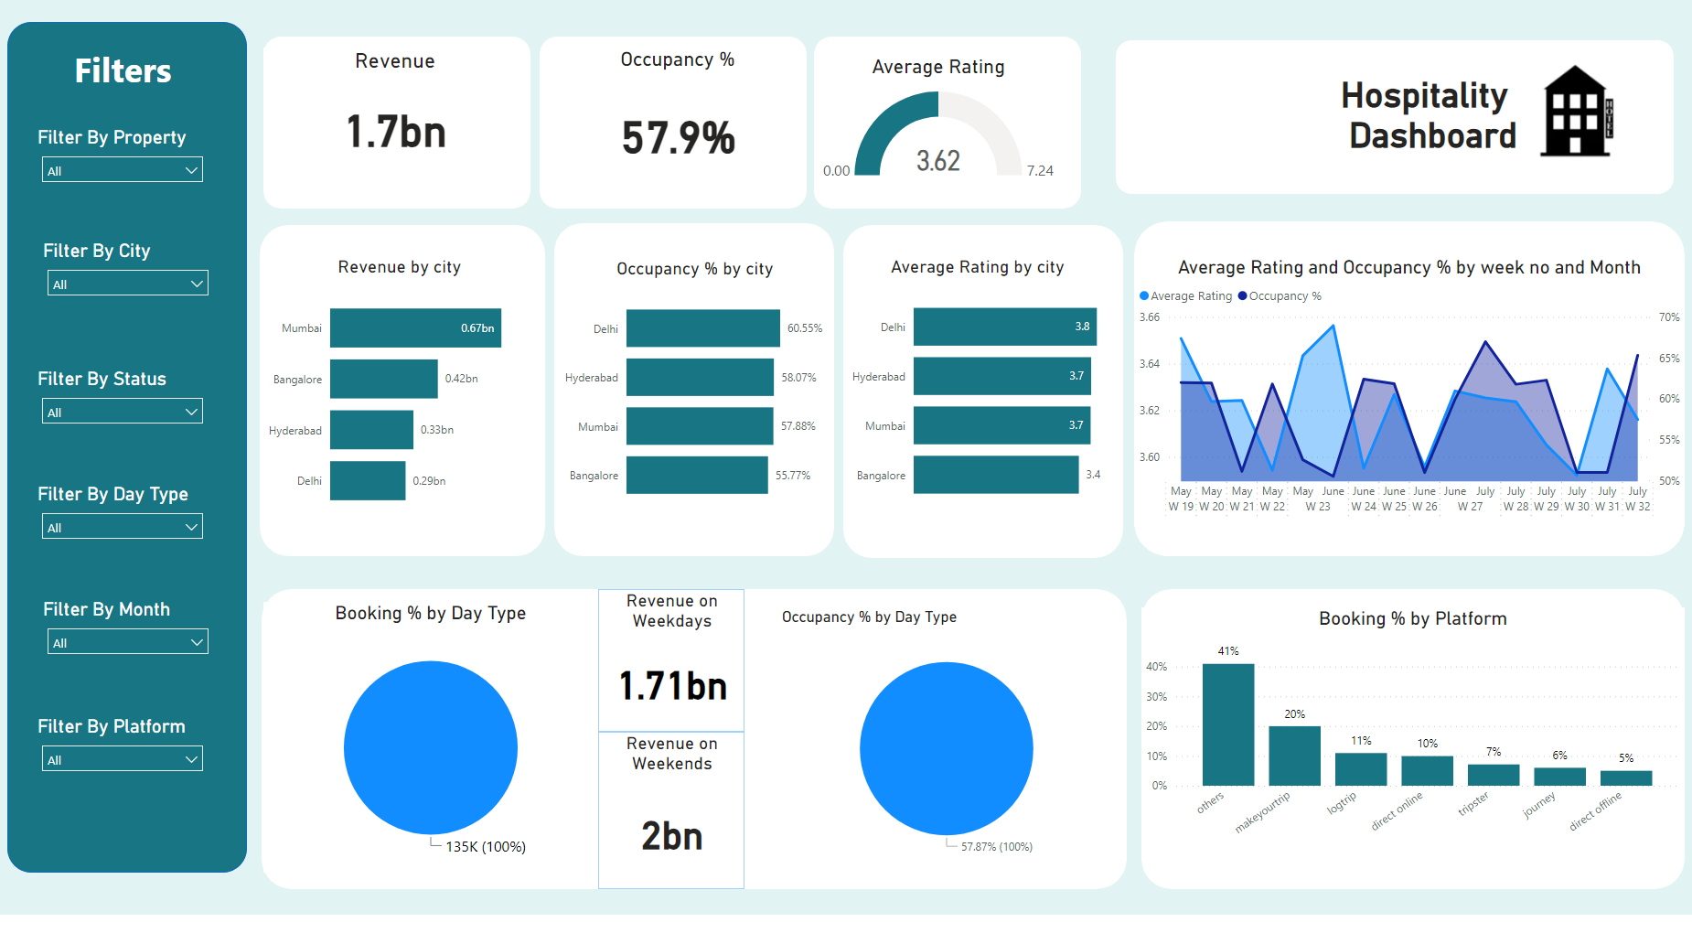
p1
Notes:
Filter By Property
No alt text provided
Filter By Status
No alt text provided
Filter By City
No alt text provided
Filter By Platform
No alt text provided
Filter By Month
No alt text provided
Filter By Day Type
No alt text provided
Occupancy %
No alt text provided
gauge
No alt text provided
textbox
No alt text provided
barChart
No alt text provided
barChart
No alt text provided
barChart
No alt text provided
areaChart
No alt text provided
Booking % by Day Type
No alt text provided
Revenue on Weekdays
No alt text provided
Revenue on Weekends
No alt text provided
Occupancy % by Day Type
No alt text provided
Booking % by Platform
No alt text provided
image
No alt text provided
shape
No alt text provided
textbox
No alt text provided
Revenue
No alt text provided
shape
No alt text provided
shape
No alt text provided
shape
No alt text provided
shape
No alt text provided
shape
No alt text provided
shape
No alt text provided
shape
No alt text provided
shape
No alt text provided
shape
No alt text provided
shape
No alt text provided

Slide 6
Insights :
The overall Revenue is 1.71 millions and Occupancy % 57.9 % is for the overall 3 months .
The record contains 4 cities in those Mumbai has higher Revenue of 0.67 billions and secondly Bangalore gives revenue of 0.42 billions.
Delhi has high occupied rooms is of 60.55% and also have higher average rating of 3.8.
The average rating and Occupancy % graph gives us the clear understanding of which week is more occupied by the customers.
Different online platform gives suggestion for the hotels in that the other hotels gives us the maximum booking % of 41 % which is profitable for the Atliq Grands

Slide 7
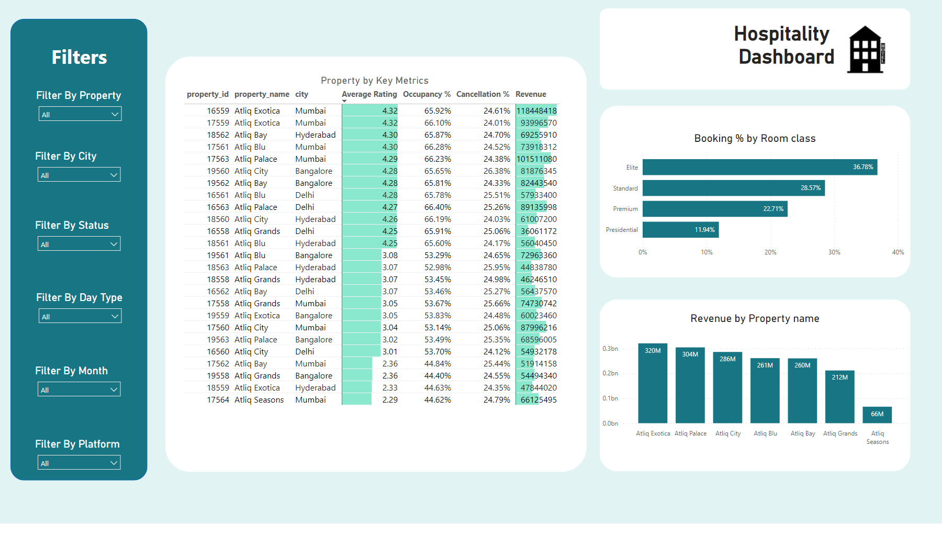
p2
Notes:
Filter By Property
No alt text provided
Filter By Status
No alt text provided
Filter By City
No alt text provided
Filter By Platform
No alt text provided
Filter By Month
No alt text provided
Filter By Day Type
No alt text provided
Property by Key Metrics
No alt text provided
image
No alt text provided
textbox
No alt text provided
Booking % by Room class
No alt text provided
Revenue by Property name
No alt text provided
shape
No alt text provided
textbox
No alt text provided
shape
No alt text provided
shape
No alt text provided
shape
No alt text provided
shape
No alt text provided

Slide 8
Insights :
Elite rooms have high preference because which is booked by most of the customers of booking % of 36.78 % .
Atliq Exotica property have greater Revenue of 320 millions than the other properties, while Atliq Seasons have very low Revenue of 66 millions .
The president room has very low booking % than other rooms

Slide 9
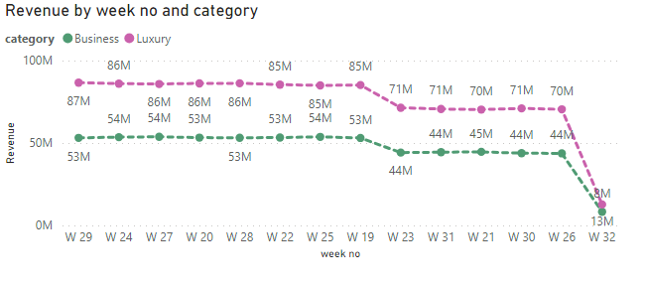
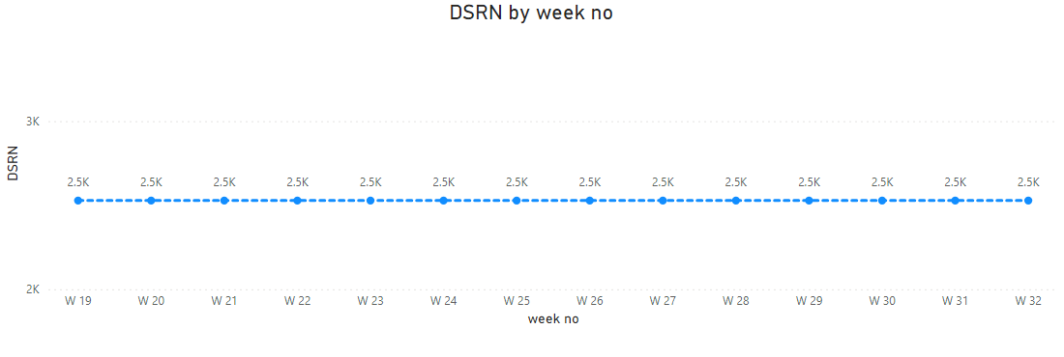
Tooltip-Revenue
Notes:
lineChart
No alt text provided

Slide 10
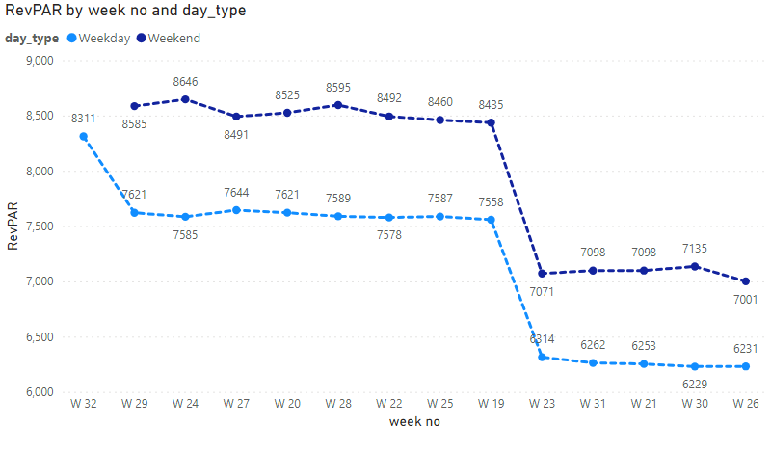
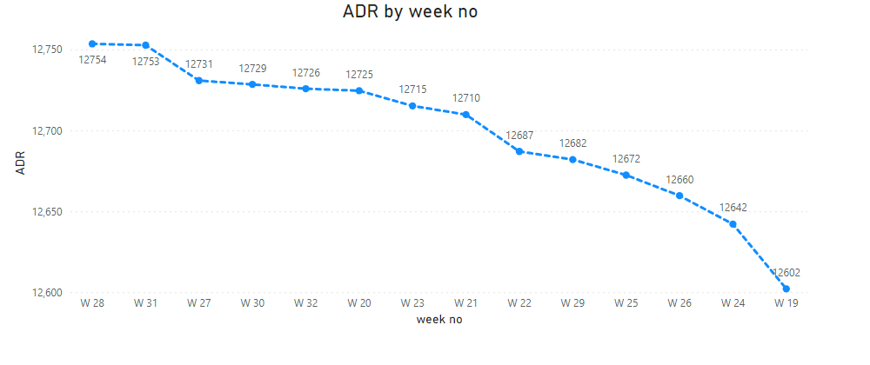
Tooltip-RevPAR
Notes:
lineChart
No alt text provided

Slide 11
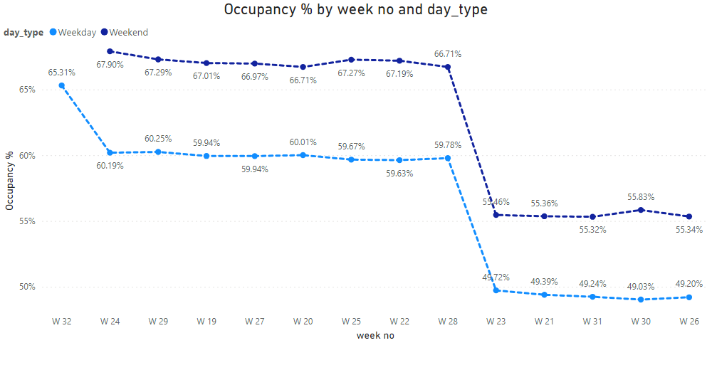
Tooltip-Occupancy
Notes:
lineChart
No alt text provided

Slide 12
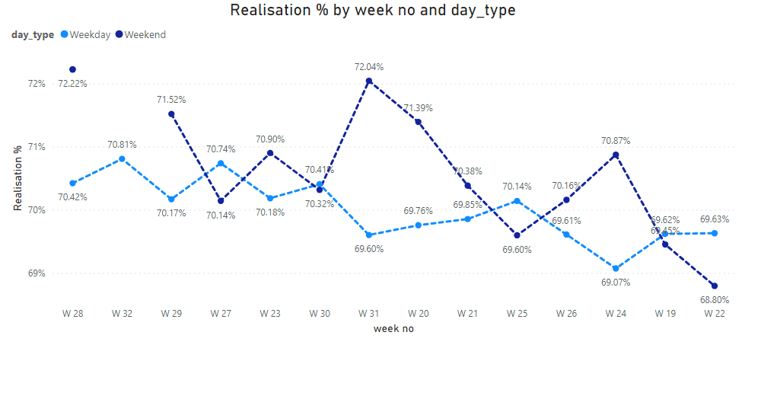
Tooltip-Realisation
Notes:
lineChart
No alt text provided

Slide 13
Thank You !

